Slide 1
Predicting Air Quality in Salt Lake City
Dzevad Fitozovic
Michael Northrup
Grant(Rob) Olsen

Slide 2
Objective
Create an air quality forecast for Salt Lake City

Slide 3
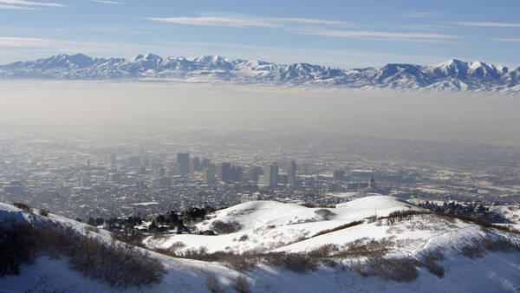
The Idea
Our primary objective is to devise a model to obtain an air quality forecast much like we have a weather forecast. We did not find any source for an air quality forecast that goes beyond one day. A short term model can be useful in warning sensitive groups of upcoming poor air quality days. As a result, we decided to do a five day forecast.

Slide 4
Data Sources, Collection, and Cleaning
What data do we use, how do we collect it, and how do we organize it for analysis

Slide 5
Data Sources

Slide 6
Data Collection

Slide 7
Data Cleaning

Slide 8
Preliminary Analysis

Slide 9
Model Selection

Slide 10
Results

Slide 11
Thank you for your time
Questions?

